Slide 1
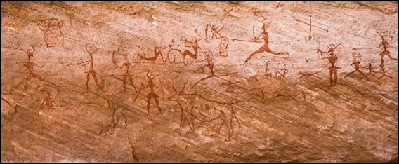
Opener
What do you see?
What does this mean?
What was the purpose of drawing?

Slide 2
Bantu Migrations
Standard:
SSWH1 Analyze the origins, structures, and interactions of societies in the ancient world from 3500 BCE/BC to 500 BCE/BC.
d. Identify the Bantu migration patterns and contribution to settled agriculture.

Slide 3
Objectives
Student can identify the geographical location of the origin of the Bantu
Student can identify the geographical migration of the Bantu
Student can state the cause of the Bantu Migration
Student can name significant revolutionary advances
Student can state effects of migration.
Student can discuss technology related to Bantu
SSWH1 Analyze the origins, structures, and interactions of societies in the ancient world from 3500 BCE/BC to 500 BCE/BC.
d. Identify the Bantu migration patterns and contribution to settled agriculture.

Slide 4
BANTU MIGRATIONS
The Bantu expansion or Bantu migration was a millennia-long series of migrations of speakers of the original Bantu language group
Bantu - a family of languages widely spoken in the southern half of the African continent
Bantu - of or relating to the African people who speak one of the Bantoid languages or to their culture; "the Bantu population of Sierra Leone"
SSWH1 Analyze the origins, structures, and interactions of societies in the ancient world from 3500 BCE/BC to 500 BCE/BC.
d. Identify the Bantu migration patterns and contribution to settled agriculture.

Slide 5
Who are the Bantu?
A group of people who began in Central Africa who went from hunter gathers to farming
  Crops such as wheat, barley, sorghum, and millet.
  Domestication of animals such as sheep and goats.
The people who spoke the language are commonly called Bantu Peoples. They are not a unified nation, simply a group of people who speak the same language.
The word “Bantu” comes from the root word “ntu” which means “people.”
SSWH1 Analyze the origins, structures, and interactions of societies in the ancient world from 3500 BCE/BC to 500 BCE/BC.
d. Identify the Bantu migration patterns and contribution to settled agriculture.

Slide 6
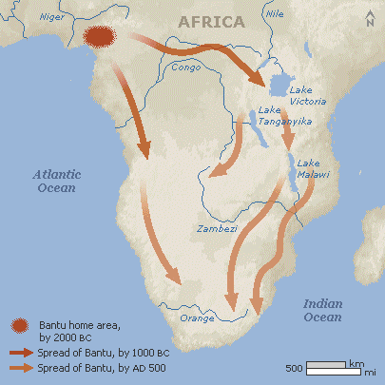
Bantu Migration
The Bantu migrations happened in two waves.
The first migration occurred between 2000 and 1000 BCE.
The second occurred between 1000 and 500 BCE.
SSWH1 Analyze the origins, structures, and interactions of societies in the ancient world from 3500 BCE/BC to 500 BCE/BC.
d. Identify the Bantu migration patterns and contribution to settled agriculture.

Slide 7
Bantu Migration
The migrations happened VERY SLOWLY.
Using primitive iron tools the Bantu would farm a plot of land for two or three years, but then the nutrients would be gone from the soil.
They originally lived in the savanna south of the Sahara in the area that is now Southeastern Nigeria.
SSWH1 Analyze the origins, structures, and interactions of societies in the ancient world from 3500 BCE/BC to 500 BCE/BC.
d. Identify the Bantu migration patterns and contribution to settled agriculture.

Slide 8
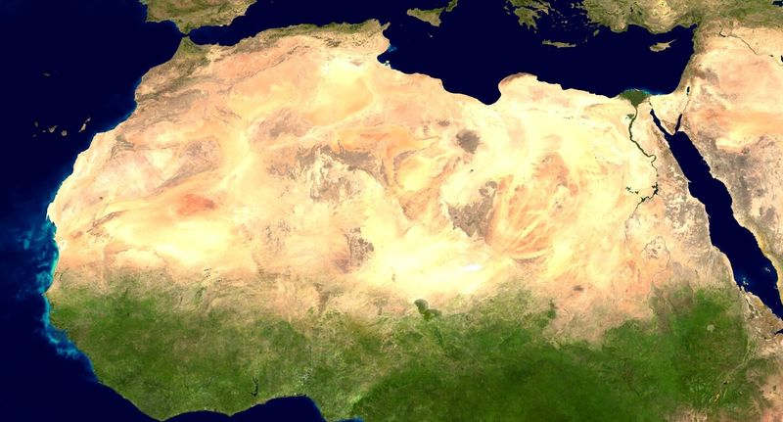
Why Not Go North?
SSWH1 Analyze the origins, structures, and interactions of societies in the ancient world from 3500 BCE/BC to 500 BCE/BC.
d. Identify the Bantu migration patterns and contribution to settled agriculture.

Slide 9
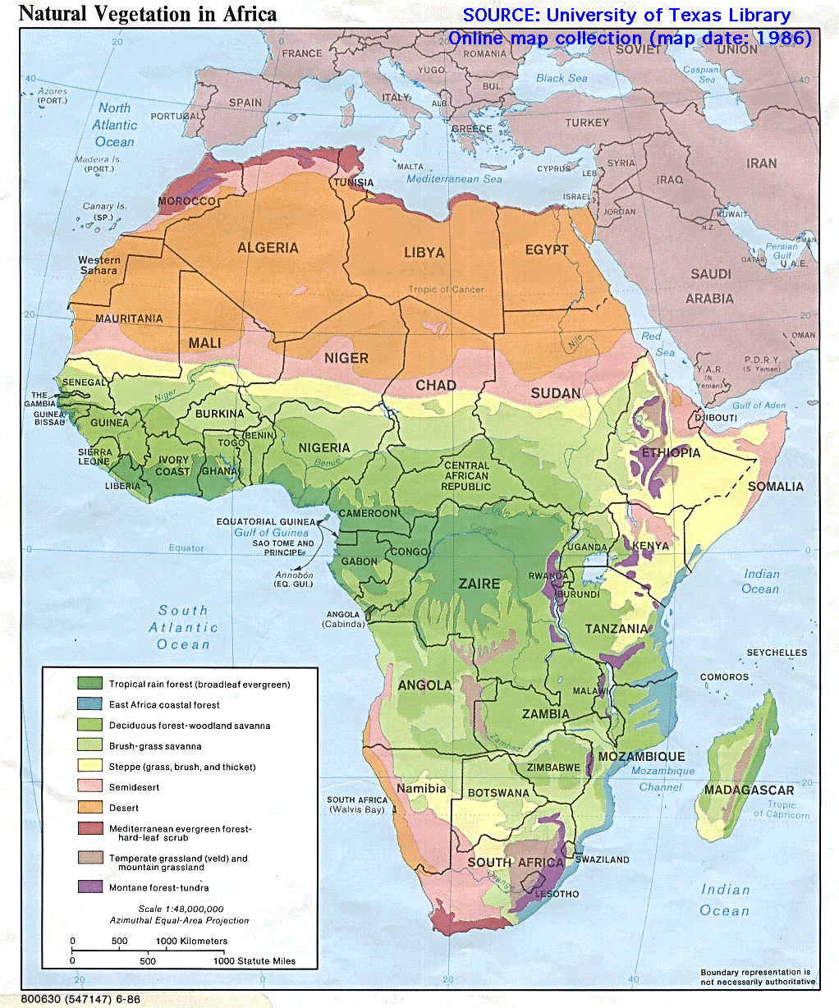
SSWH1 Analyze the origins, structures, and interactions of societies in the ancient world from 3500 BCE/BC to 500 BCE/BC.
d. Identify the Bantu migration patterns and contribution to settled agriculture.

Slide 10
Causes of Migration
Farming techniques forced them to find new land to farm
Used the Slash and Burn technique
Increased population forced some to find new areas to live and farm
SSWH1 Analyze the origins, structures, and interactions of societies in the ancient world from 3500 BCE/BC to 500 BCE/BC.
d. Identify the Bantu migration patterns and contribution to settled agriculture.

Slide 11
Effects of the Migration
Largest unforced human migration in history
Spread a language group
Forced native peoples like the BaMuti and the San who were hunter gathers out of the area.
SSWH1 Analyze the origins, structures, and interactions of societies in the ancient world from 3500 BCE/BC to 500 BCE/BC.
d. Identify the Bantu migration patterns and contribution to settled agriculture.

Slide 12
More effects
Intermarriage caused a spread of culture
New technology of ironworking and weapons from copper, bronze, and iron
Spread farming techniques throughout the continent of Africa
SSWH1 Analyze the origins, structures, and interactions of societies in the ancient world from 3500 BCE/BC to 500 BCE/BC.
d. Identify the Bantu migration patterns and contribution to settled agriculture.

Slide 13

https://www.youtube.com/watch?v=d2CkqHdkUcI
SSWH1 Analyze the origins, structures, and interactions of societies in the ancient world from 3500 BCE/BC to 500 BCE/BC.
d. Identify the Bantu migration patterns and contribution to settled agriculture.

Slide 14
Assignment
Students will write at least one page answering the following:
Explain the significance of the Bantu migrations. (DOK 3)
Cite Evidence to support how the Bantu made an impact on sub-Saharan Africa. (DOK 3)
Due at the beginning of class on Tuesday.
SSWH1 Analyze the origins, structures, and interactions of societies in the ancient world from 3500 BCE/BC to 500 BCE/BC.
d. Identify the Bantu migration patterns and contribution to settled agriculture.

